Slide 1

Impact of Social Media on Children

Slide 2
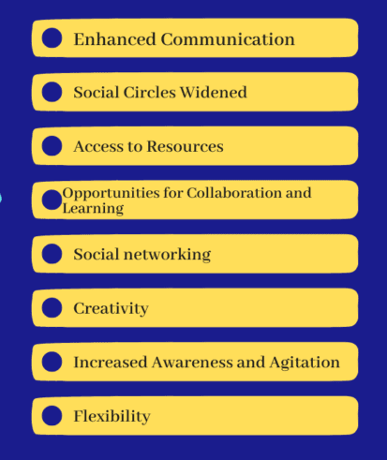
Positive Impacts
Educational Benefits:
Access to educational resources and tutorials.
Opportunities for collaborative learning and discussion.
Social Connections:
Staying connected with friends and family.
Opportunities to meet new people with similar interests.
Creativity and Expression:
Platforms for sharing artwork, writing, and other creative works.
Development of digital literacy skills.

Slide 3
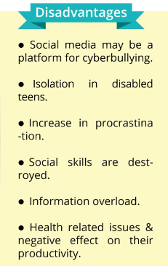
Negative Impacts
Mental Health Issues:
Increased risk of anxiety, depression, and low self-esteem.
Effects of cyberbullying and online harassment.
Addiction and Screen Time:
Excessive use leading to decreased physical activity and sleep disturbances.
Impact on academic performance and real-life social interactions.
Privacy and Security Concerns:
Risks of data breaches and personal information exposure.
Potential for online exploitation and grooming.

Slide 4
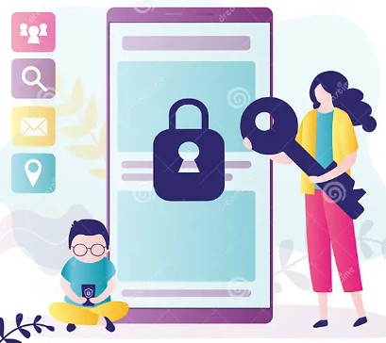
Parental and Educational Guidance *SETTING LIMITS- Recommendations for screen time and appropriate content. Encouraging offline activities and hobbies. *Open Communication- Discussing the dangers of social media and encouraging openness. Educating children about privacy settings and online behavior. *Monitoring and Support- Using parental controls and monitoring tools. Providing support and intervention if needed.

Slide 5
Best Practices for Children Creating Strong- *Passwords: Importance of unique and secure passwords. *Being Mindful of Sharing: appropriate share online. *Recognizing Red Flags: Identifying potential dangers and knowing how to respond.

